Slide 1
Exploring the new HelpDesk System of Region One
Division/Office:
Business Operations & Finance Support
Information Technology

Slide 2
Quick Overview of our Old and New Service Request Ticketing System
Topics we will cover:
How and Where to login
Review old and new style of our ticketing system requirements
Added features with new ticketing system
Walk through for creating a new service request and view submitted request

Slide 3
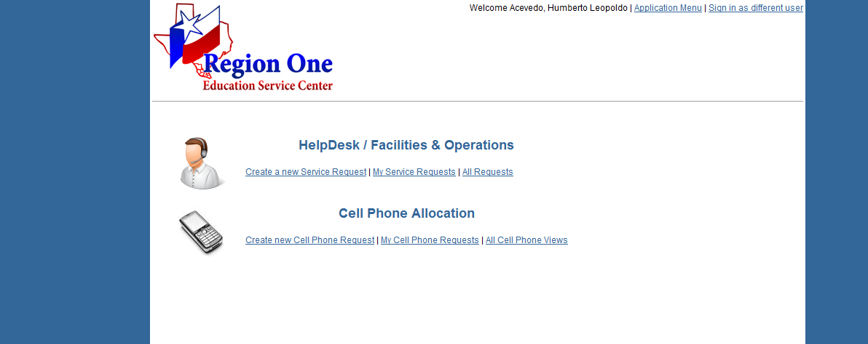
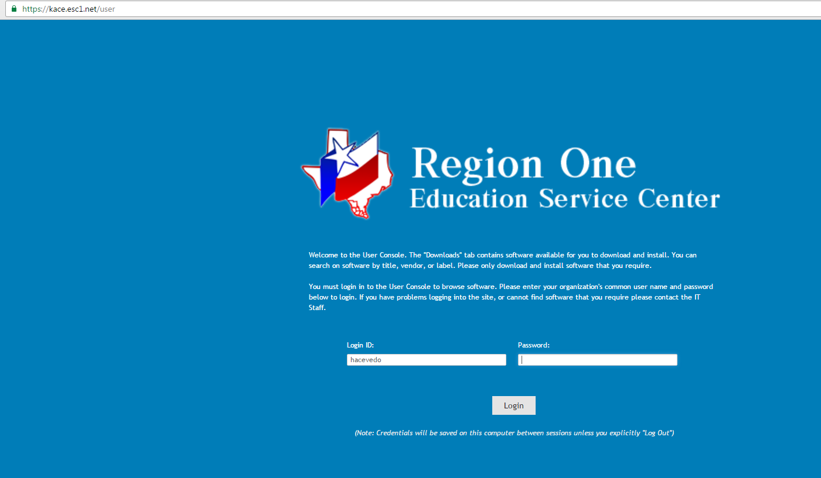
Current Ticketing System & New Ticketing System

Slide 4
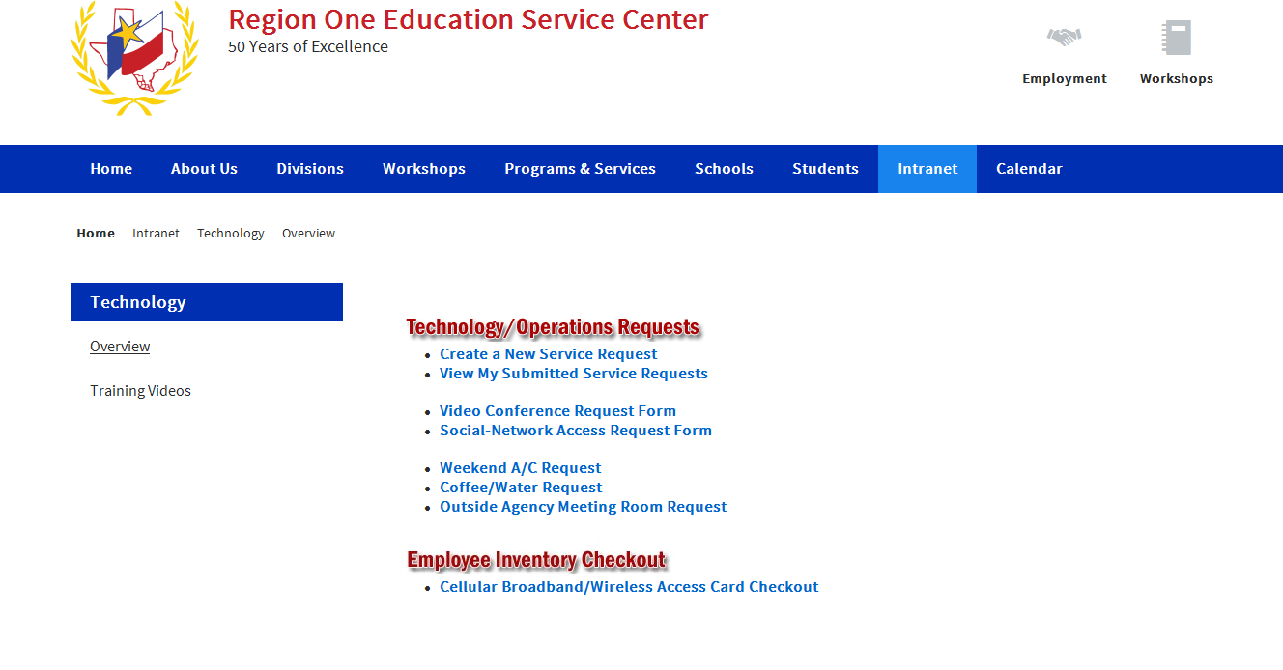
Access to our Service Request System
Sign In with your ESC credentials
Hover over Intranet and select Technology
Select Create a New Service Request

Slide 5
Current Service Request System
(Fazing out current system)

Slide 6
Current functionality when creating a request
Requirements:
Department
Issue
Room Number
Affected User
Contact Phone
Comments
Attachment

Slide 7
My Service Request

Slide 8
New Service Request System
(same theory)

Slide 9
KACE Service Request System https://kace.esc1.net/user

Slide 10
Access with Browser & Login
If you want to save it as a favorite on your browser and bypass signing in then you can use the following url: https://kace.esc1.net/user
Use your ESC credentials to Login (full email address is not required for Login ID. Ex: hacevedo and current password)

Slide 11
New look for our Help Desk
Submit a ticket
View ticket status
View Announcements
Helpful links
Downloads

Slide 12
New Ticket Options
IT Help Desk
Facilities
Information Systems
Programmers

Slide 13
Creating a New Service Request
Title: Is required
Summary: Will assist with the detail of the issue
Impact: 1 or all users
Site: Currently location HQ
Category: Dropdown list to choose from (ex: phone, computer, printer, etc.)
Affected User: Click Add CC and select user from dropdown list or type “Self” if you’re having the issue
Attachments: Optional (ex: user emailed you screenshot of issue)
Screenshots: Optional (ex: you are the affected user and supply a screenshot)
Apply Changes and Save

Slide 14
Once Apply Changes is clicked

Slide 15
Once the Save option is clicked

Slide 16
After Ticket submission

Slide 17
Once we close out the Ticket
You will receive an email
Review resolution
Add comments if needed
Review history

Slide 18
The End Lets review - https://kace.esc1.net/user
Contact Information:
Help Desk Department
984-6061

